Slide 1
Team Pioneers presents
The Halloween Night
Developed By-
Rajeshri Sonwane
Rutvik PensionWar
Sunny Udhani
Varun shah
Vishweshkumar patel

Slide 2
Project deliverables
Team’s UML diagrams
Final Task Board
Final Cumulative Flow diagram
Final Scrum Burndown Chart
Team’s Project Retrospective

Slide 3
UML Class Diagram

Slide 4
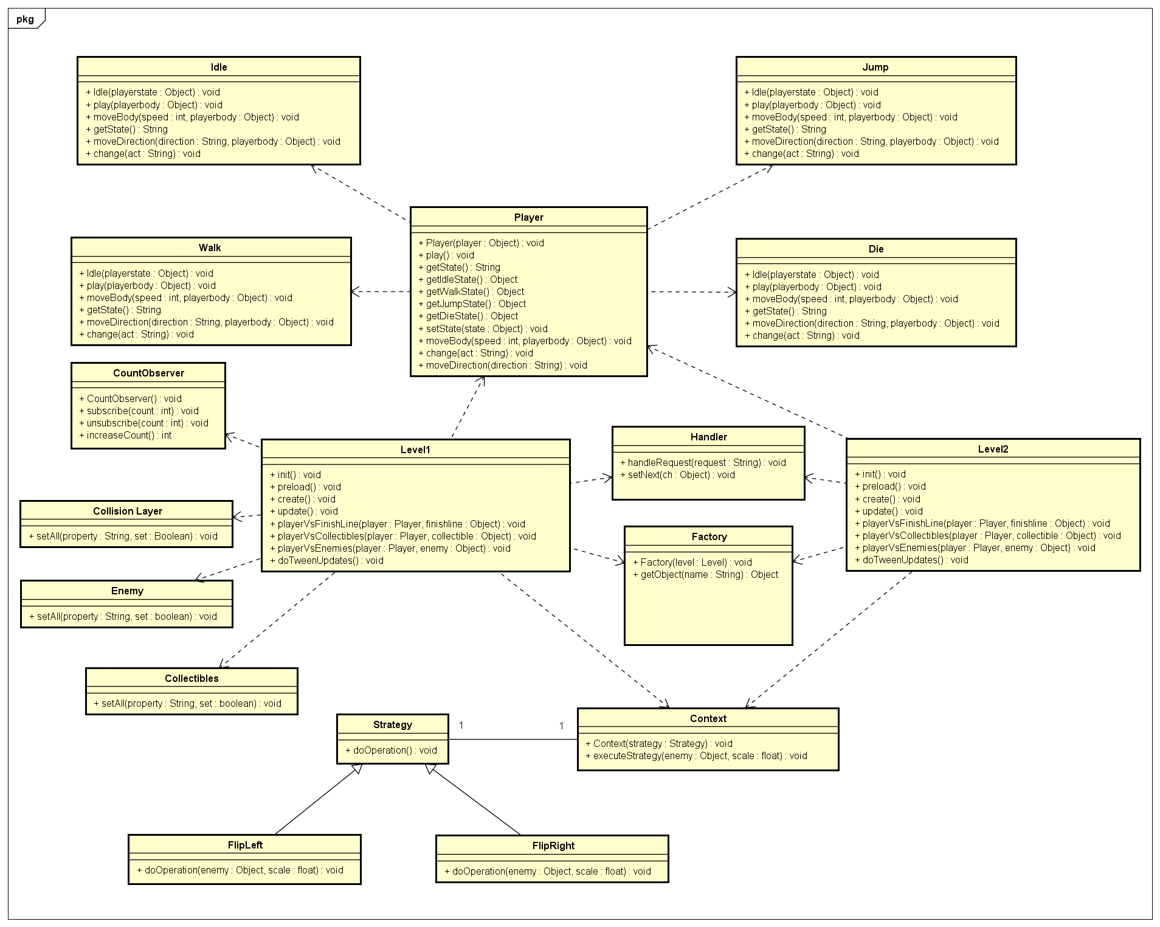

Slide 5
UML Sequence Diagram

Slide 6
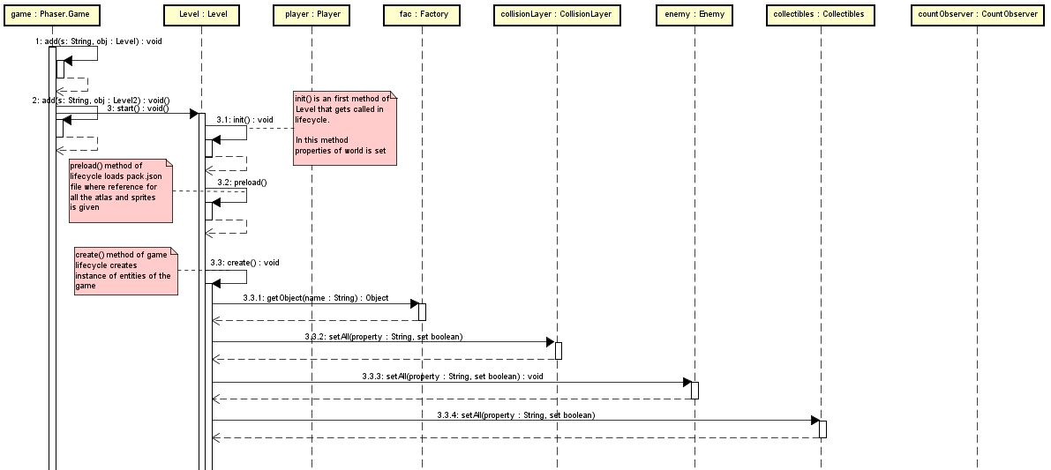

Slide 7
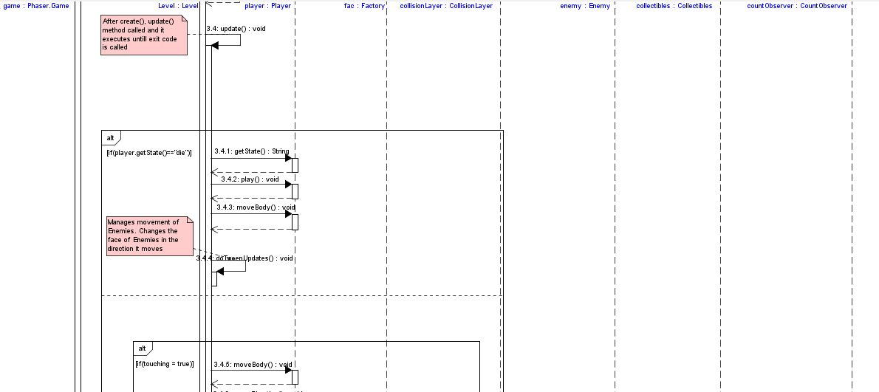

Slide 8
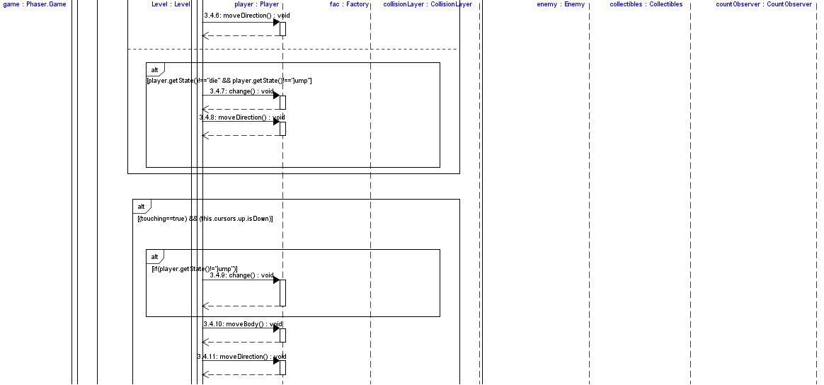

Slide 9
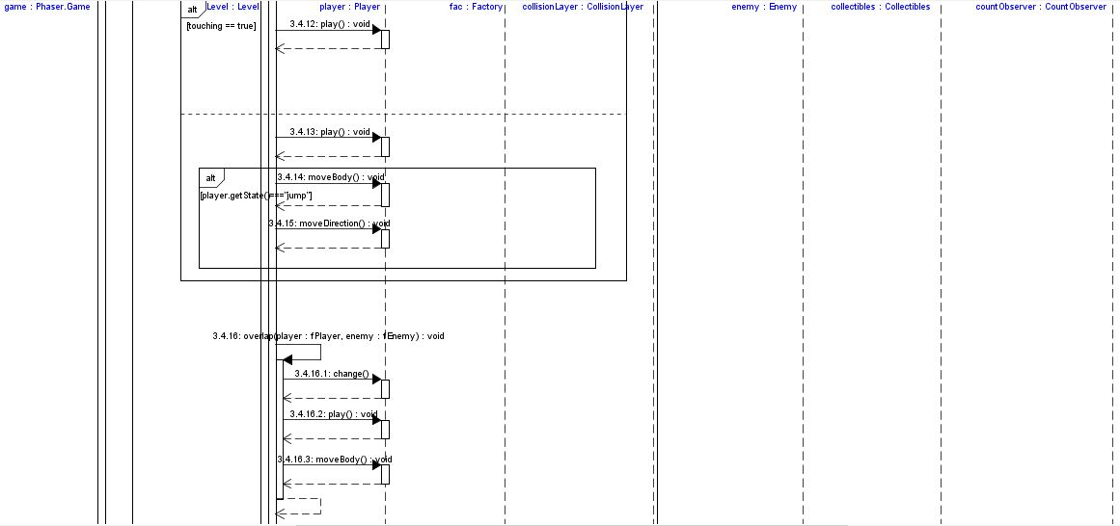

Slide 10
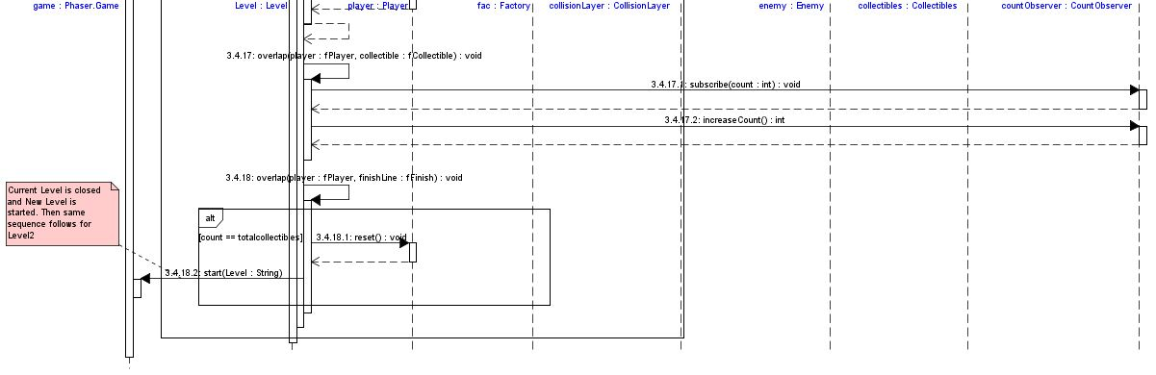

Slide 11
UML Activity Diagram

Slide 12
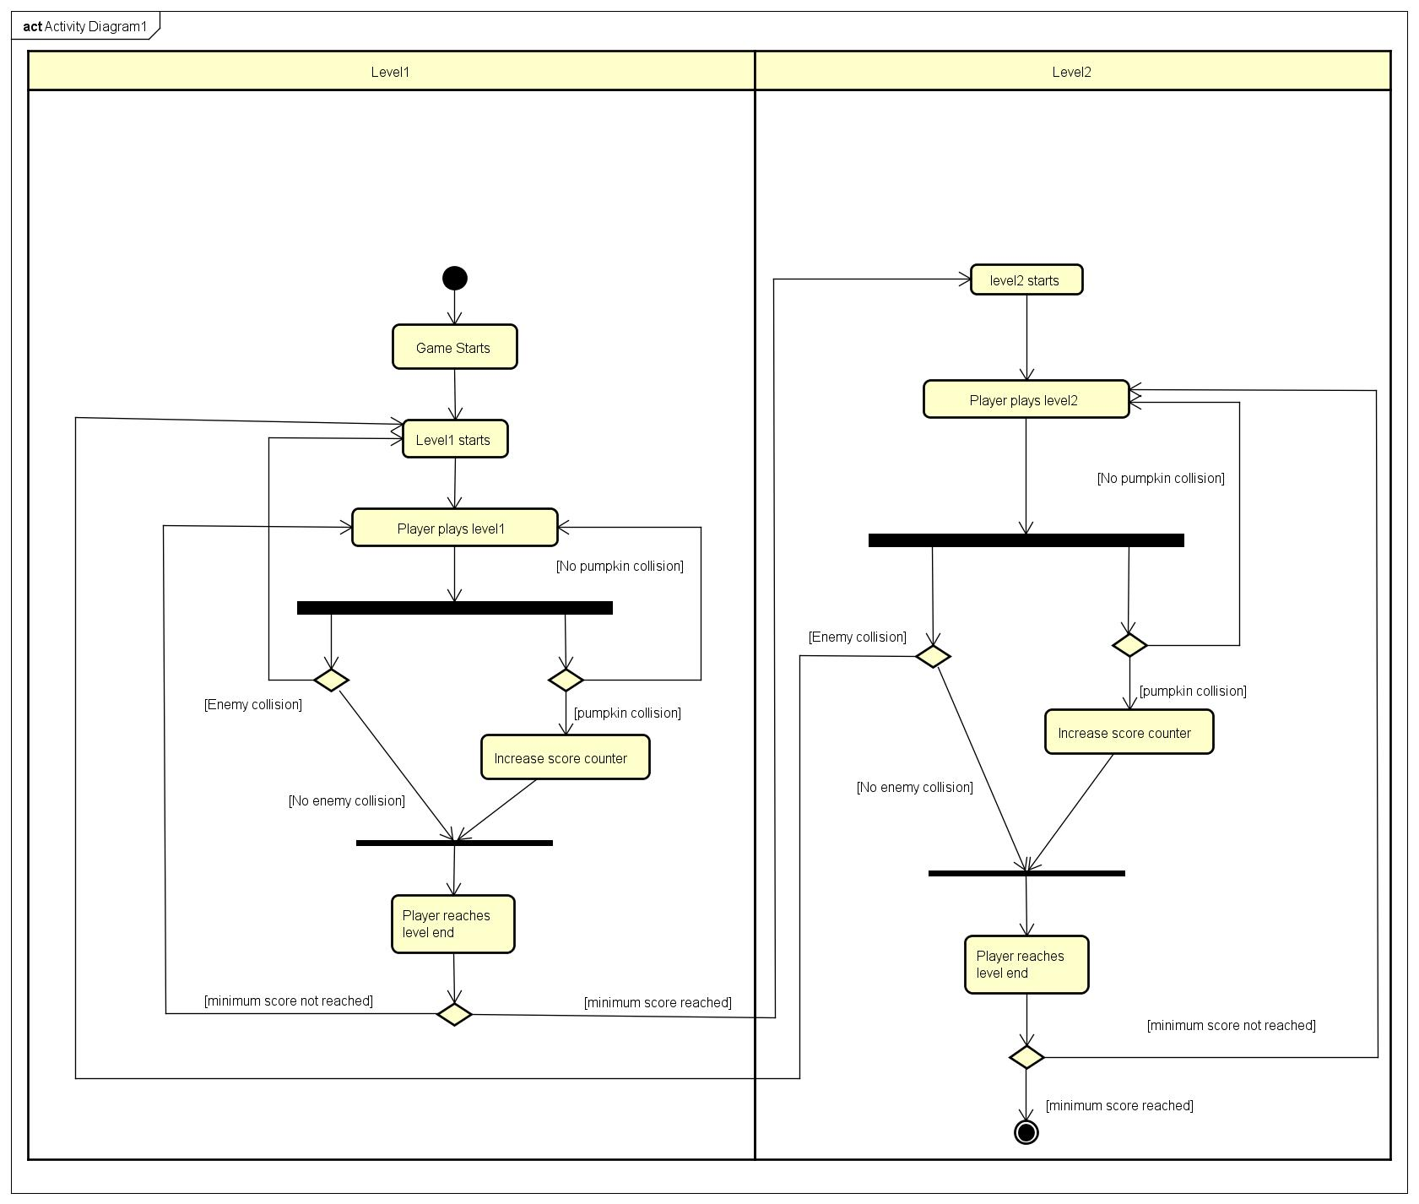

Slide 13
UML Use Case Diagram

Slide 14
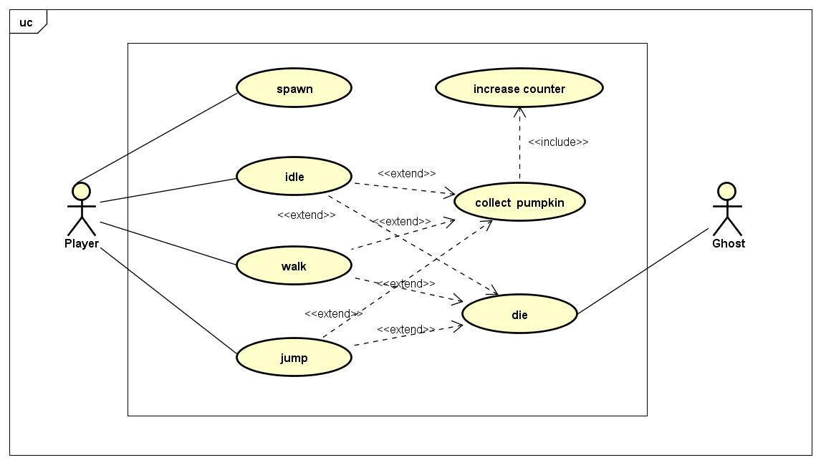

Slide 15
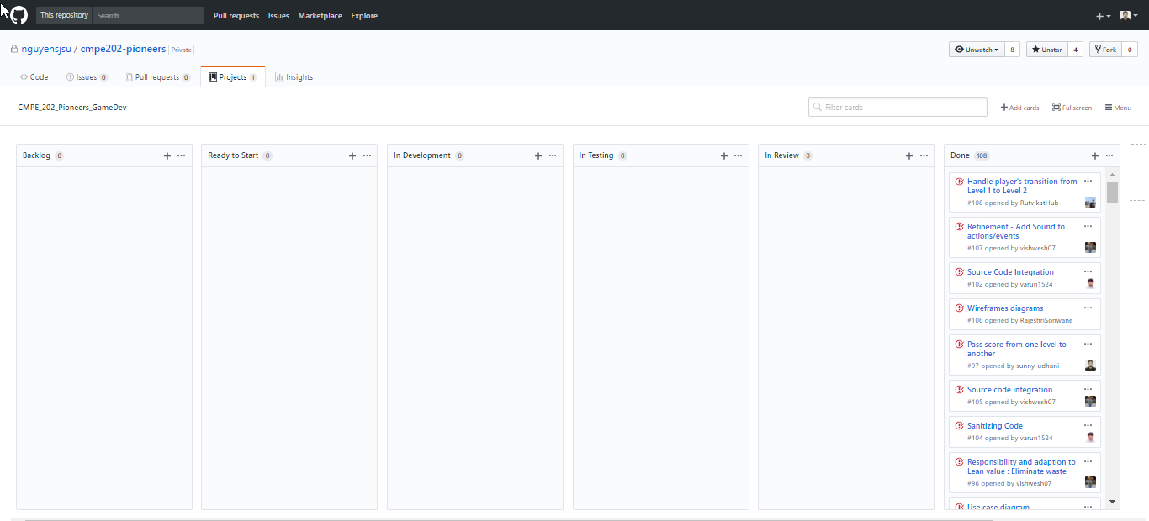
Final Task Board

Slide 16
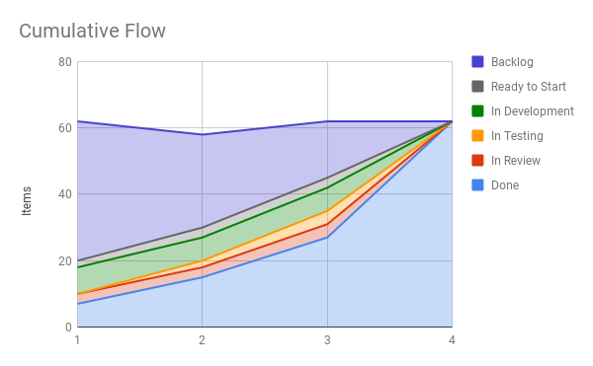
Final Cumulative Flow Diagram

Slide 17
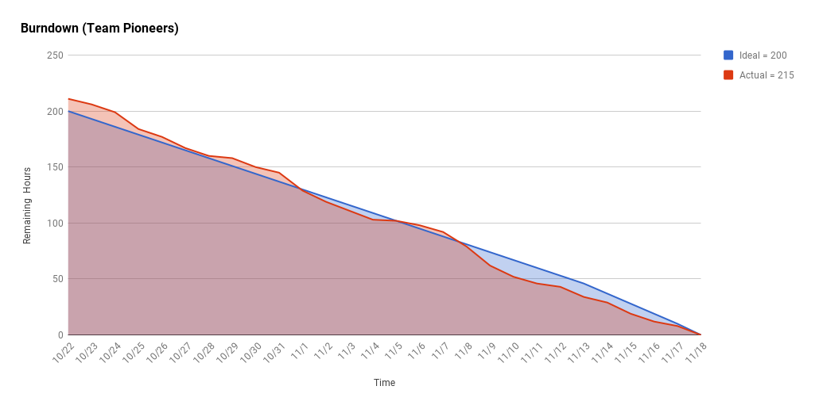
Final Scrum Burndown chart

Slide 18
Team Retrospective
What worked well for us?
  Level 1 and level 2 works as per user requirements.
  Embedding Observer, Chain of responsibility, State, Factory, Strategy, and Composite design patterns resulted in low coupling and high cohesion.
  Assigning different XP and lean core value to each team member for different weeks, gave us chance to understand each core value's importance.
  Following agile methodologies with Kanban and Scrum, we were able to track assigned tasks, roadblocks to complete tasks, etc. through GitHub task board, Cumulative flow diagram generated from Kanban task sheet and Burndown chart generated from Sprint task sheet.
What did not work well for us?
  Due to lack of knowledge of Phaser framework, we were not able to design front page to give start and pause.
  Phaser provides inbuilt functionality to create JavaScript file for scenes based on canvas of scene, thus embedding design pattern to such scene.js was difficult task.
  We thought about including couple of features like fire power and gave 3 lives to player character to make game comparatively more exciting and interactive but couldn’t accomplish it within the timeframe.
What actions can we take to improve our process going forward?
  Regular merging of changes in source directory to check "Is snippet working well up on integration with game developed till date?“ because of teams’ premature understanding about git.
  Further explore Phaser framework to develop high-end game or a featureful game start page.
  Implement a process to track requirement changes related to a user story, in a way that code changes and check-ins can be linked to differentiate amongst changes.

Slide 19
Game on!!!
Prezi Presentation : https://prezi.com/p/z0qzst3x35kw/
GitHub repo : https://github.com/nguyensjsu/cmpe202-pioneers
GitHub Task Board : https://github.com/nguyensjsu/cmpe202-pioneers/projects/2

